Slide 1
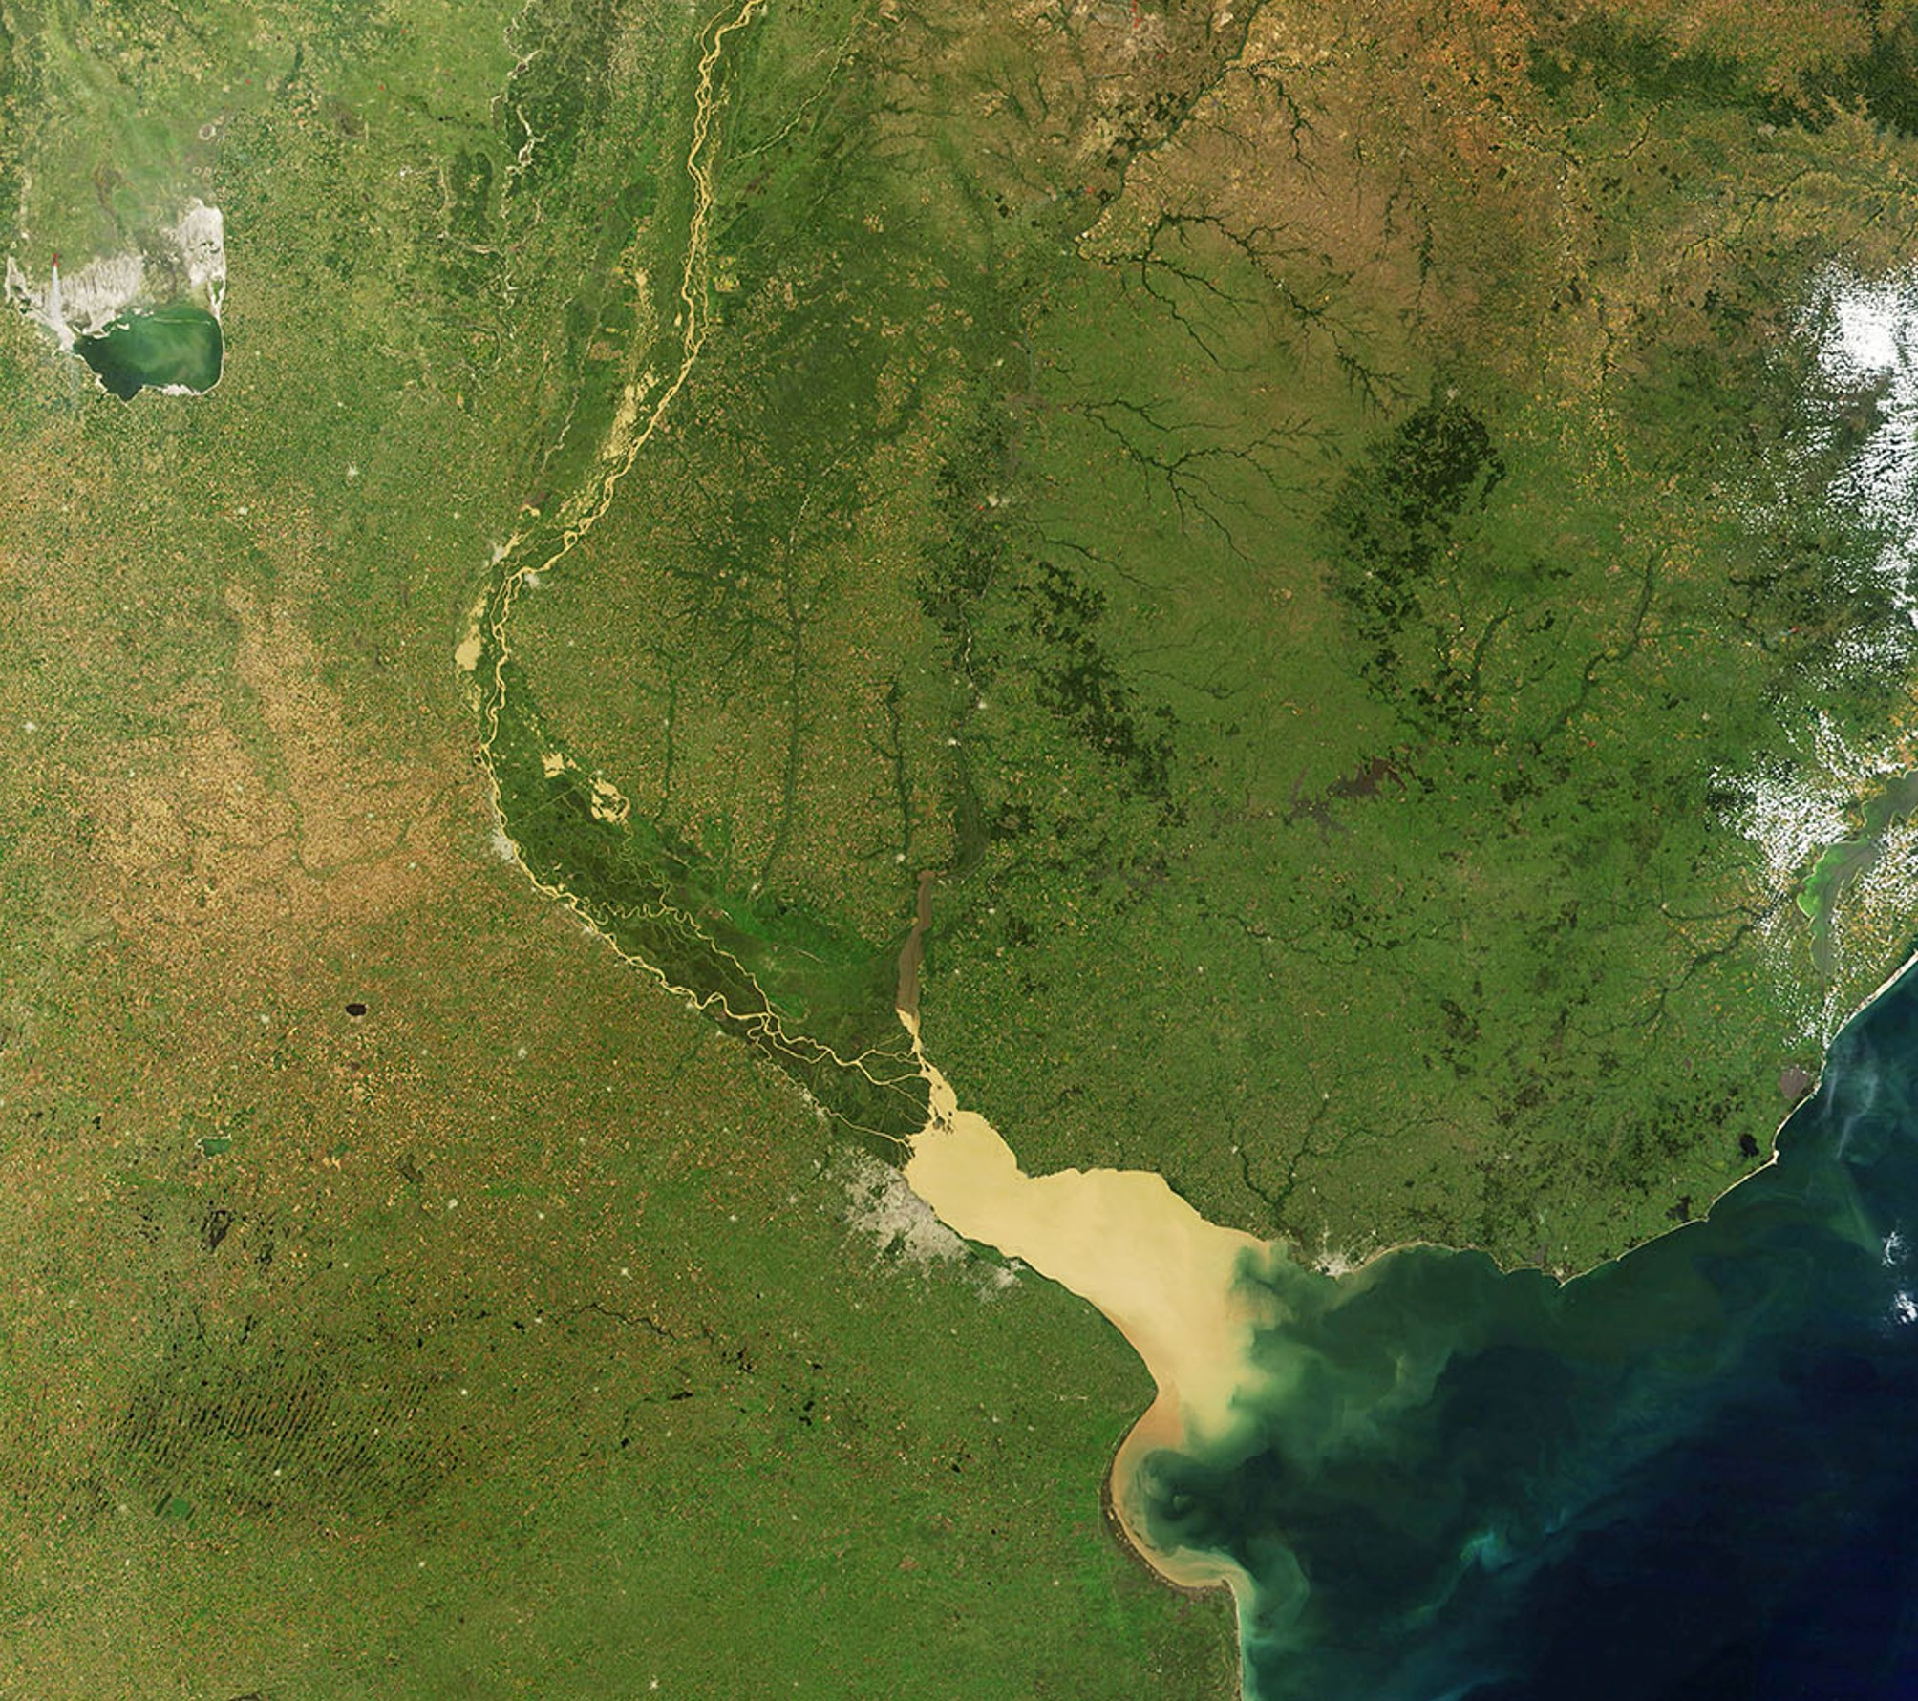

Early diagenetic alterations of sterol biomarkers during particle settling and burial in polluted and pristine areas of the Rio de la Plata Basin
Speranza, E.D., Colombo, M., Skorupka, C.N., Colombo, J.C.
Laboratorio de Química Ambiental y Biogeoquímica, FCNyM, UNLP

Slide 2
Summary
Describe your main findings
And the importance of your research
Include an image to illustrate your story
Replace this box with an image
Notes:
Provide a summary of your main findings, and the major relevant points. If possible, include an image that illustrates your research.

Slide 3
Why is your research important?
Answer the question “so what?” here
Explain the relevance and importance of your work
Replace this box with an image
Fusionar con anterior
Notes:
Explain the importance and relevance of your research, putting it in context.

Slide 4
Background
Provide additional information or references, or add an image or figure here
Sterols as Biomarkers
RLP background
Intro to sampling area
Put your research in context
Provide relevant background information
Build up the story so people understand your work
Notes:
Provide relevant background information that helps elucidate your findings.

Slide 5
Methods
Provide additional information or references, or add an image or figure here
Esquema trampa mas draga
Con flecha a extraccion y GCMS analysis
Usar fondo sinaqo o similar
Put your research in context
Provide relevant background information
Build up the story so people understand your work
Notes:
Present your main methods: in a nutshell, what did you do?

Slide 6
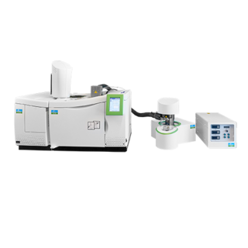
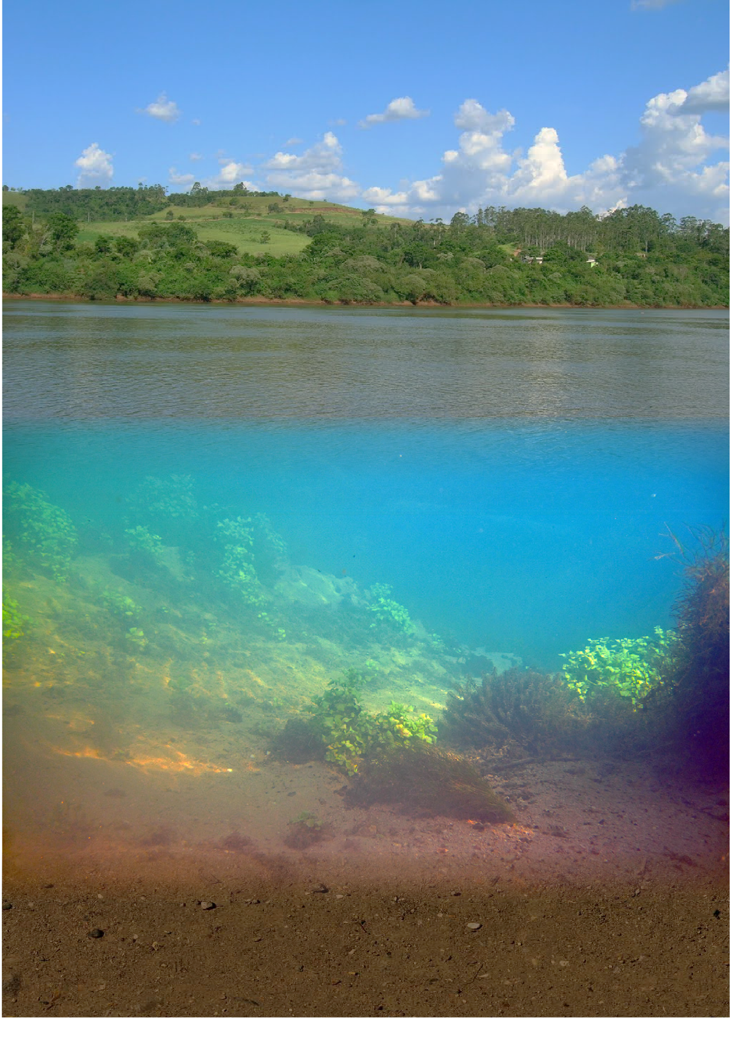
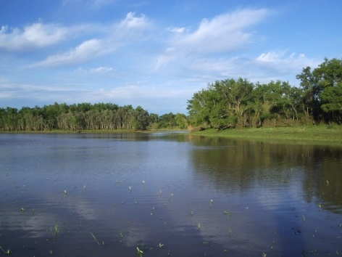

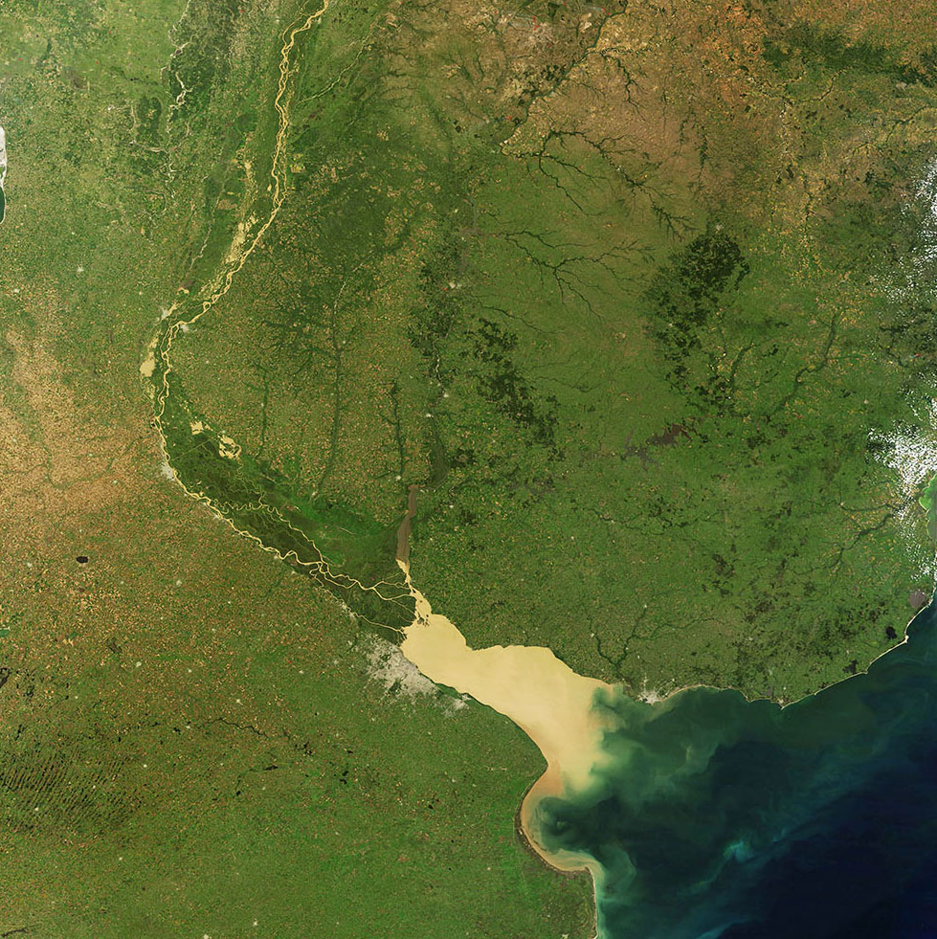
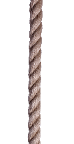
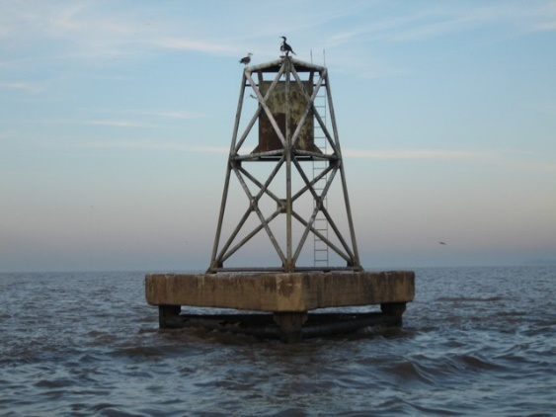
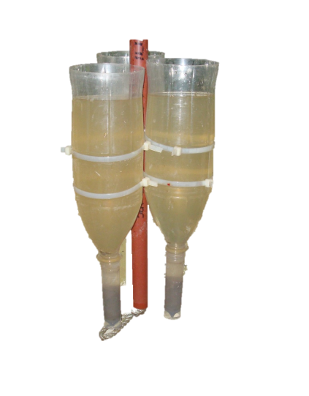
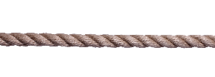
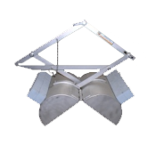
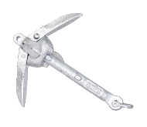
Methods
N (Uruguay river)
GCMS analysis
Lipid extraction and purification
Sediment trap
Surface sediment
BA (Buenos Aires, Rio de la Plata estuary)

Slide 7
Results
Add an image, figure or graph here (don’t make it too complicated – people may watch your presentation in a small frame)
Outline your results
Explain any surprises or anomalies
Notes:
Talk through your results – what stood out? What surprised you?

Slide 8
Flux
Sterol content
Spring-Summer
Autumn-Winter
Wet-warm
Dry-cold
Poner variacion temporal con lineas en color y sin boxplot

Slide 9
Results
Add an image, figure or graph here (don’t make it too complicated – people may watch your presentation in a small frame)
Outline your results
Explain any surprises or anomalies
Notes:
Continue to describe your results on this second slide if you need more time.

Slide 10
Conclusion
Present your conclusions
Put them in context: how do they add to the bigger picture?
Replace this box with an image
Notes:
Share what you concluded from your findings. Take it back to the “so what?” question – what’s so important about your conclusions?

Slide 11
Next steps/future work
Outline the next steps for the research
Talk about current or future research
Include a link to more information, if relevant
Provide additional information, or add an image or figure here
Notes:
Talk about next steps and future work. Where do your conclusions lead? If you’ve worked on a medical treatment or product, what’s the next step in its development? Are you working on a related but different project? Here’s the place to point readers to your new research.

